Slide 1
Secure Data hiding In image using Steganography.
CAPSTONE PROJECT
Presented By:
Student Name : Mogeswari T
College Name & Department : Anand Institute of Higher Technology & Artificial Intelligence and Data Science.

Slide 2
OUTLINE
Problem Statement
Technology used
Wow factor
End users
Result
Conclusion
Git-hub Link
Future scope

Slide 3
Problem Statement
With the increasing need for secure communication, hiding sensitive information within digital media has become crucial. This project aims to develop a Python-based GUI application using ”Tkinter” that allows users to conceal secret text messages within images using steganography.
The application should enable users to upload an image, embed a hidden message, save the encoded image, and later retrieve the concealed information securely. This ensures confidential data transmission without attracting attention.

Slide 4
Technology used
Technologies Used: Programming Language:
Python – for application development.
Libraries: •Tkinter – for creating the graphical user interface (GUI). •Pillow (PIL) – for image processing and display. •Stegano – for embedding and extracting hidden messages using Least Significant Bit (LSB) steganography. •Os – for file handling and directory management. Platform:
Local machine using Python Shell or IDEs (e.g., PyCharm, VSCode).

Slide 5
Wow factors
User-Friendly GUI:
An intuitive and interactive interface built with Tkinter, making it easy for users to hide and reveal messages without coding
knowledge. Efficient Steganography Technique:
Utilizes the Least Significant Bit (LSB) method from the Stegano library, ensuring secure and subtle message embedding within images. Multi-Format Image Support:
Allows users to work with various image formats such as PNG and JPG, enhancing flexibility. Instant Data Encoding and Decoding:
Provides real-time embedding and extraction of secret messages with simple button clicks. Secure Data Transmission:
Helps users conceal sensitive information within images, making it an effective tool for secure communication.

Slide 6
End users
Who Can Benefit from This Project (End Users): •Cybersecurity Professionals: To securely transmit sensitive data without attracting attention. •Journalists and Whistleblowers: For protecting confidential information and sources in high-risk environments. •Researchers and Academics: To safeguard sensitive research data during transmission or storage. •General Users: Anyone looking for a simple and secure way to hide personal information within images. •Educational Institutions: As a learning tool for teaching concepts of steganography, encryption, and data security.

Slide 7
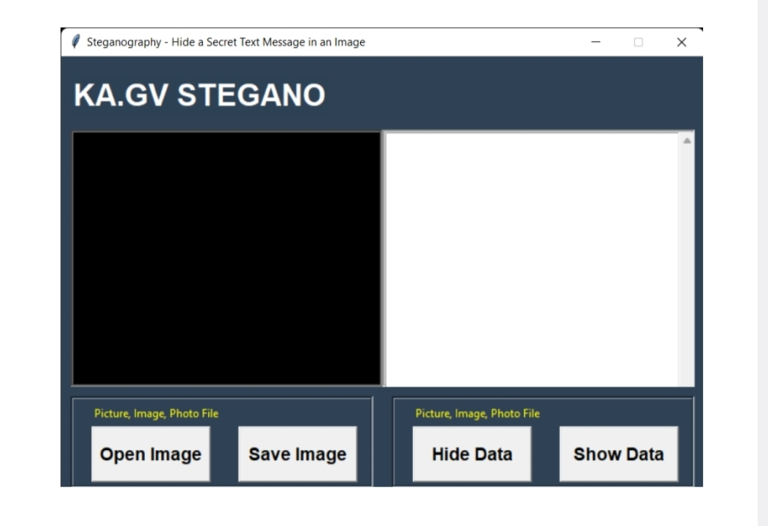
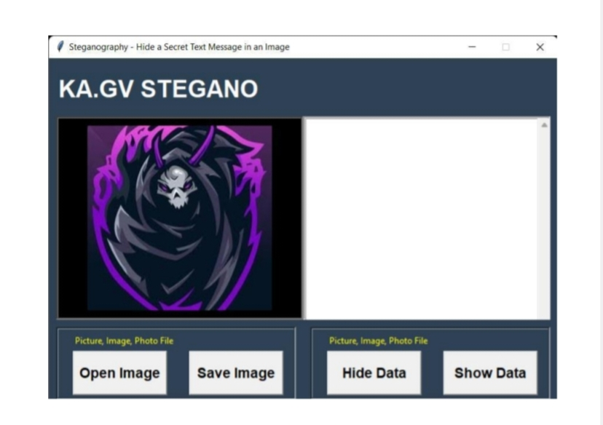
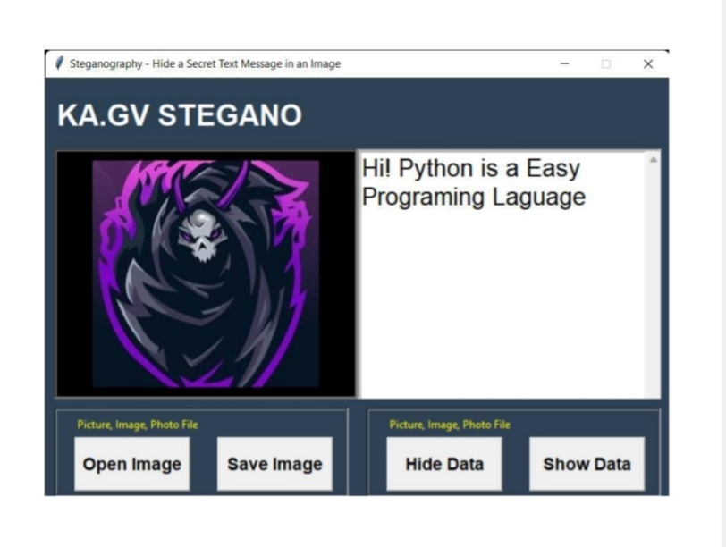
Results

Slide 8
Conclusion
In response to the growing need for secure communication, this steganography project successfully demonstrates how sensitive information can be hidden within images using a simple and user-friendly Python application. By leveraging libraries like Tkinter, Pillow and Stegano; the project allows users to seamlessly embed and extract secret messages from images. The intuitive GUI enhances accessibility for users with little to no technical background, making data concealment straightforward and efficient. This solution offers a practical approach to protecting confidential information, ensuring secure and discreet communication.

Slide 9
GitHub Link
•Make sure to check out readme file.
•GITHUB LINK :
https://github.com/Moge-13/Mogeswari_T.git

Slide 10
Future scope(optional)
Enhanced Encryption: Integrate advanced encryption algorithms to provide an additional layer of security before embedding messages. Audio and Video Steganography: Expand functionality to hide secret messages in audio and video files, increasing versatility. Password Protection: Add a feature to secure hidden messages with a password for enhanced confidentiality. Cross-Platform Compatibility: Develop versions compatible with mobile platforms (Android, iOS) and web-based interfaces for broader accessibility. Advanced Steganalysis Detection: Implement detection tools to identify any attempts at unauthorized message extraction or tampering.

Slide 11
THANK YOU

